Slide 1
CSE 216 E-commerce site
Prepared By: Farhan Tanvir Utshaw (1505105)
Masfiqur Rahaman (1505111)
Project Supervisor: Abida Sanjana
Lecturer, Department of CSE,
BUET

Slide 2
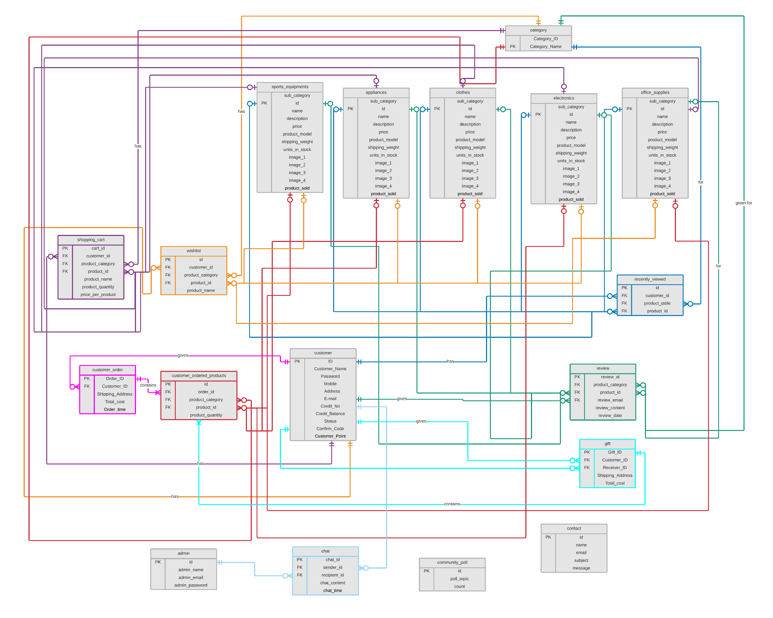

Slide 3
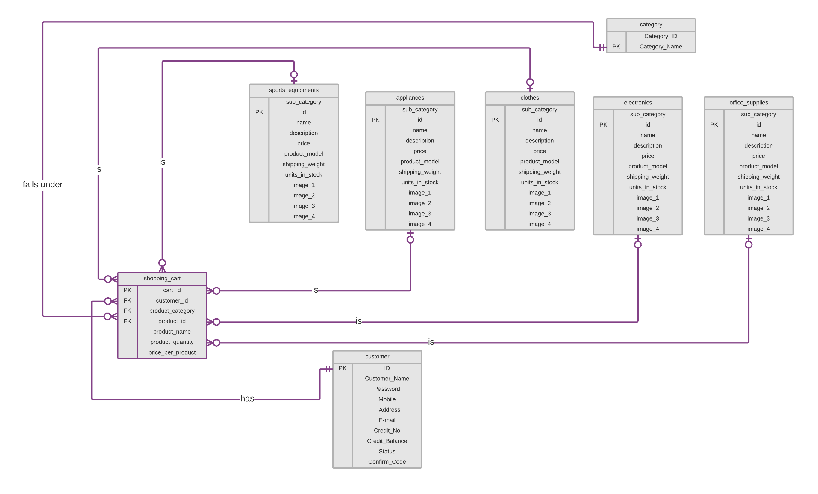

Slide 4
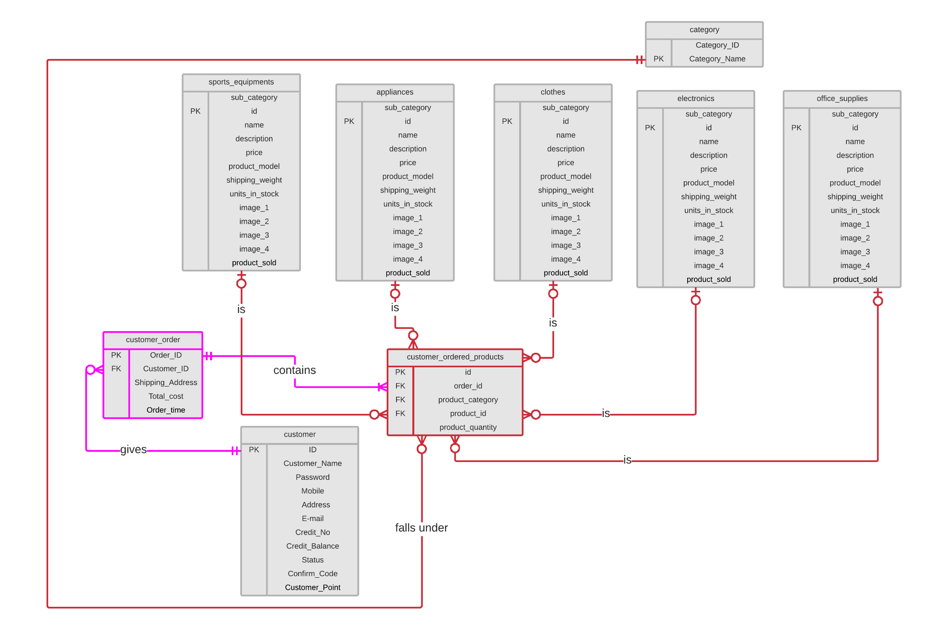

Slide 5
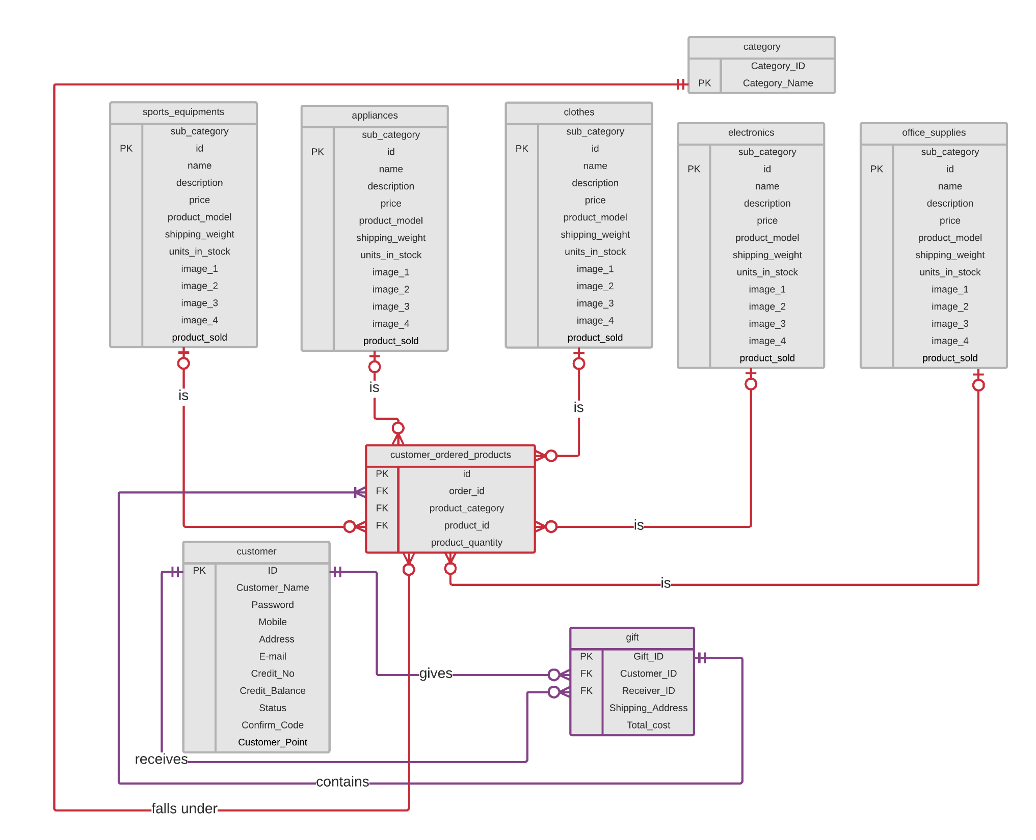

Slide 6
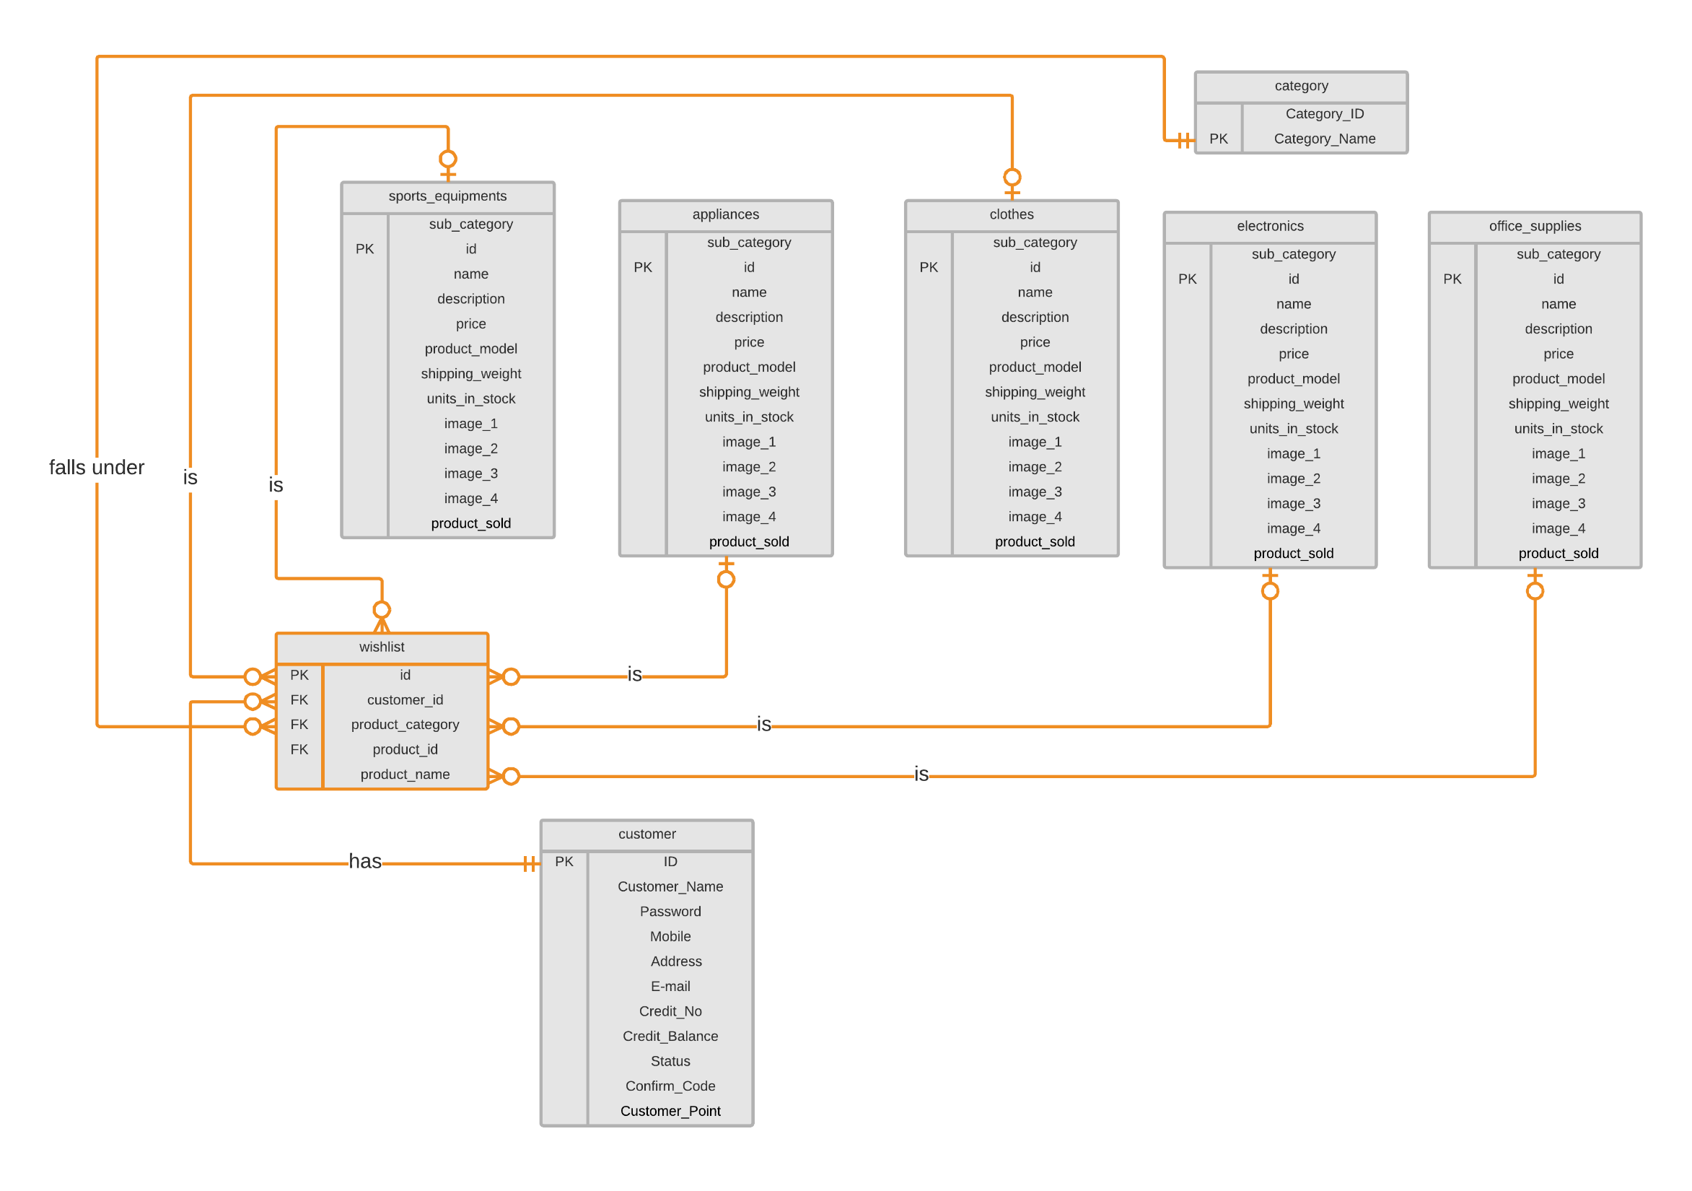

Slide 7
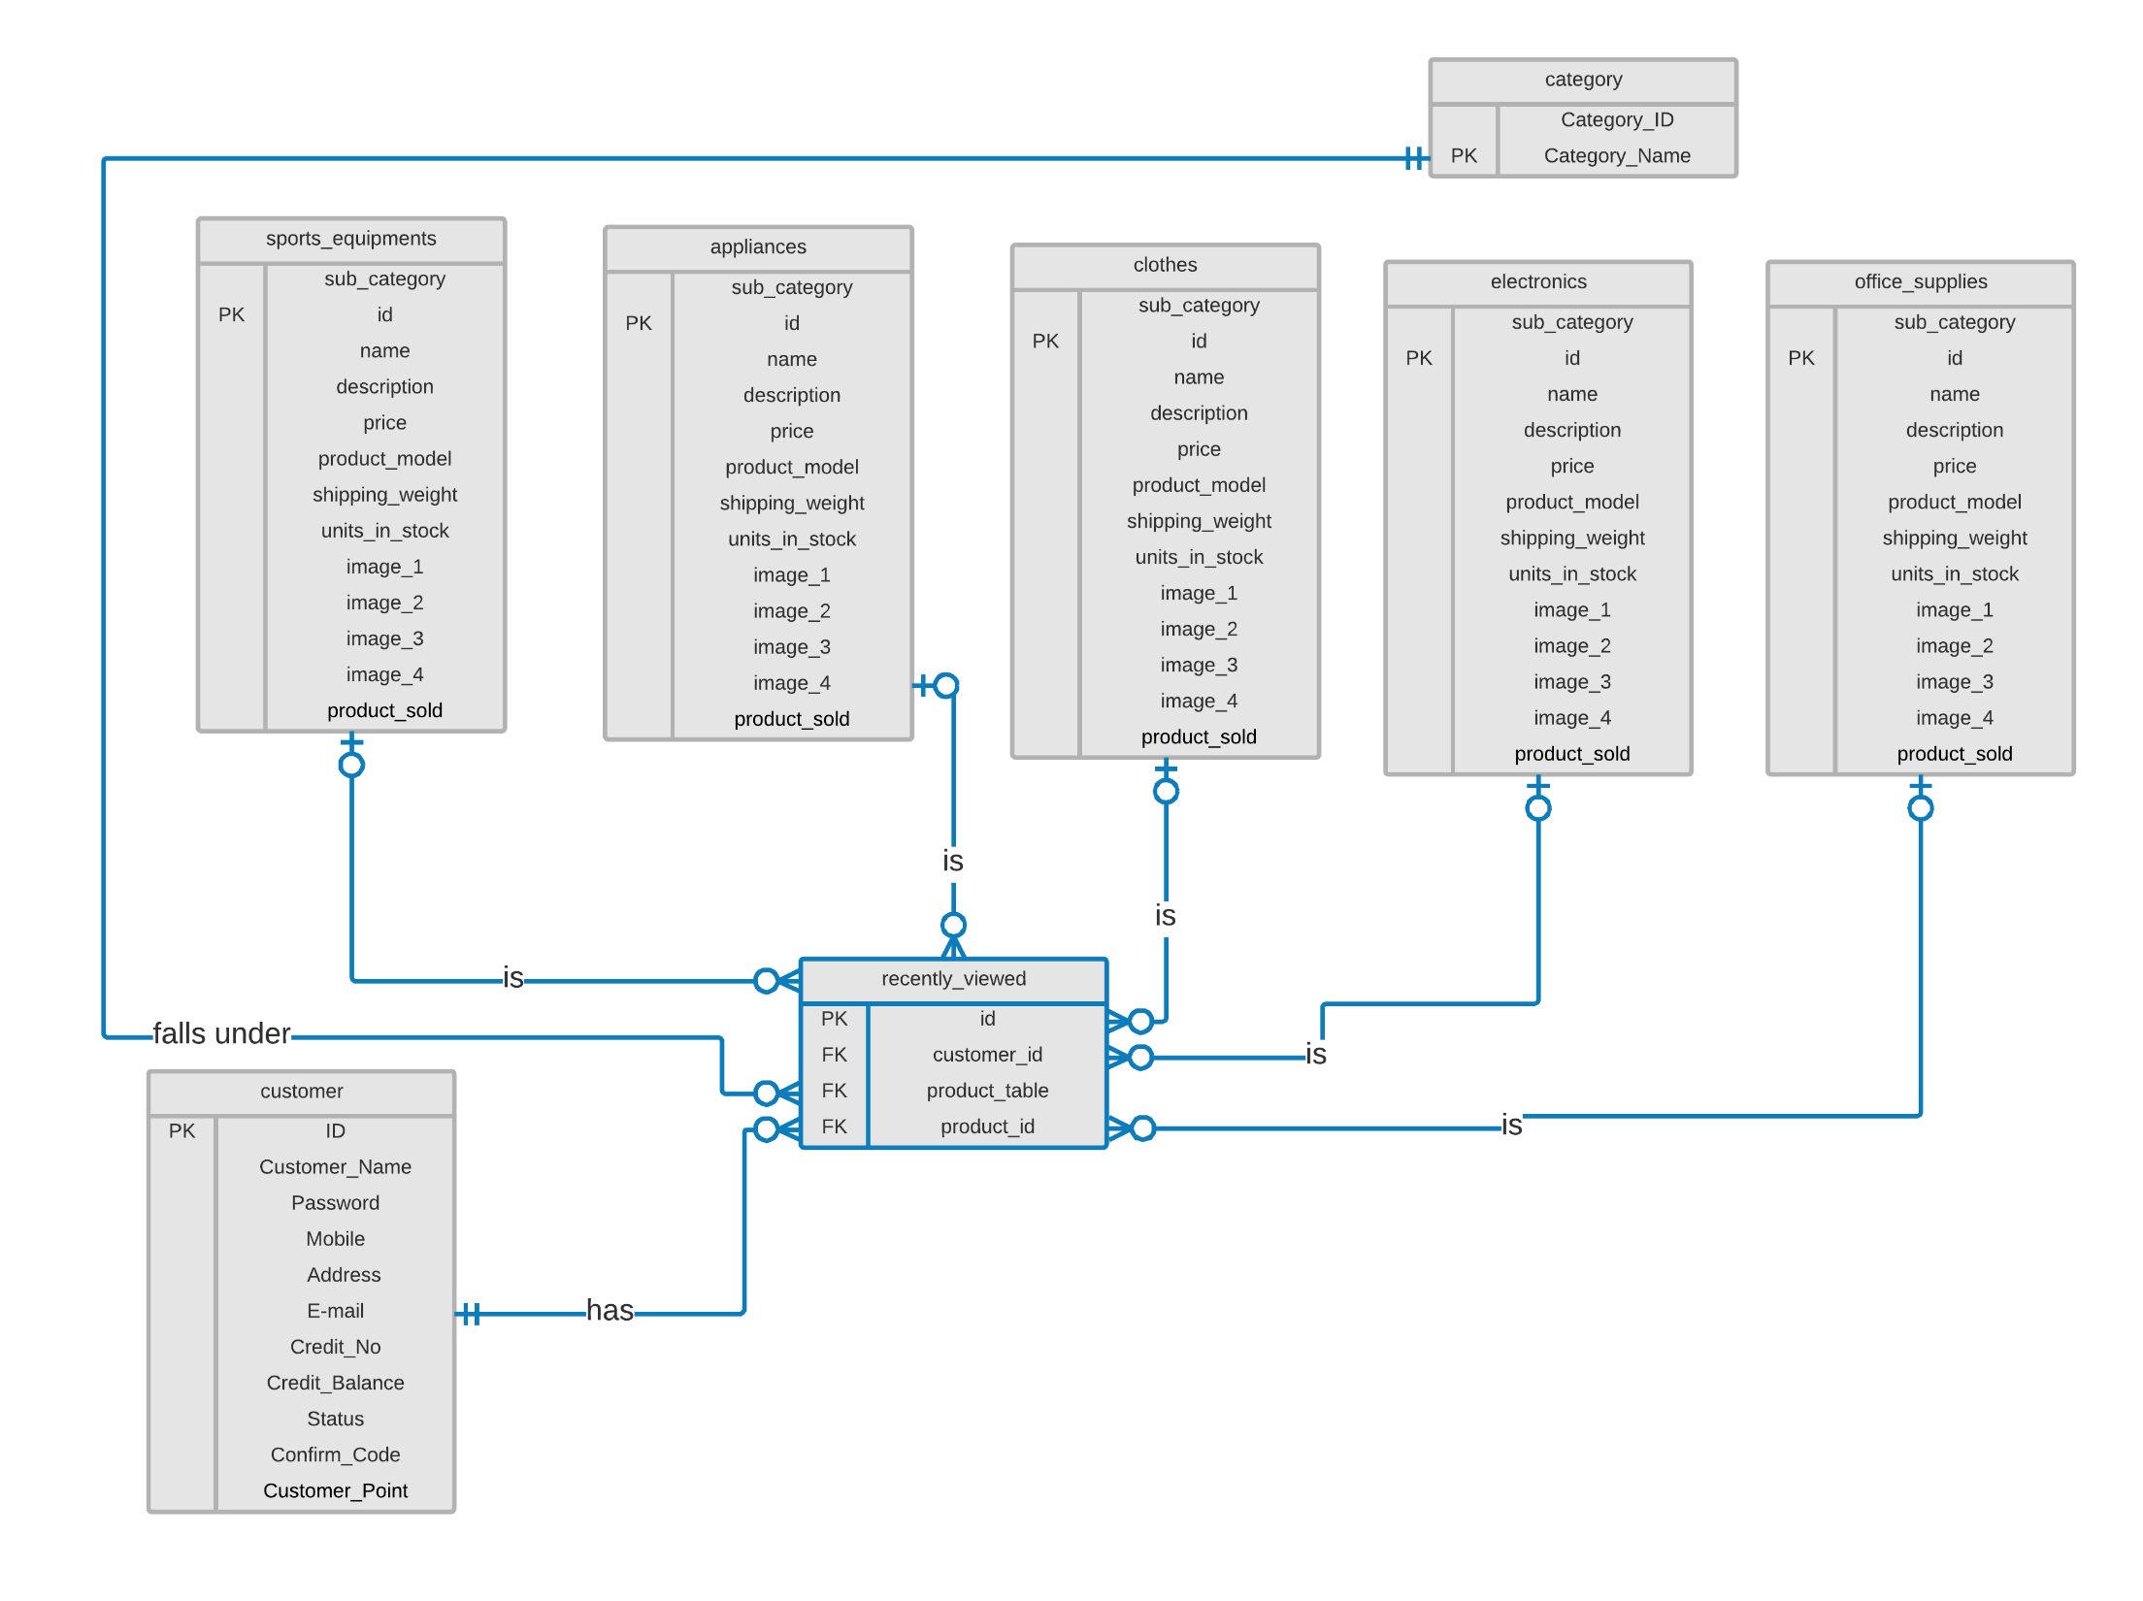

Slide 8
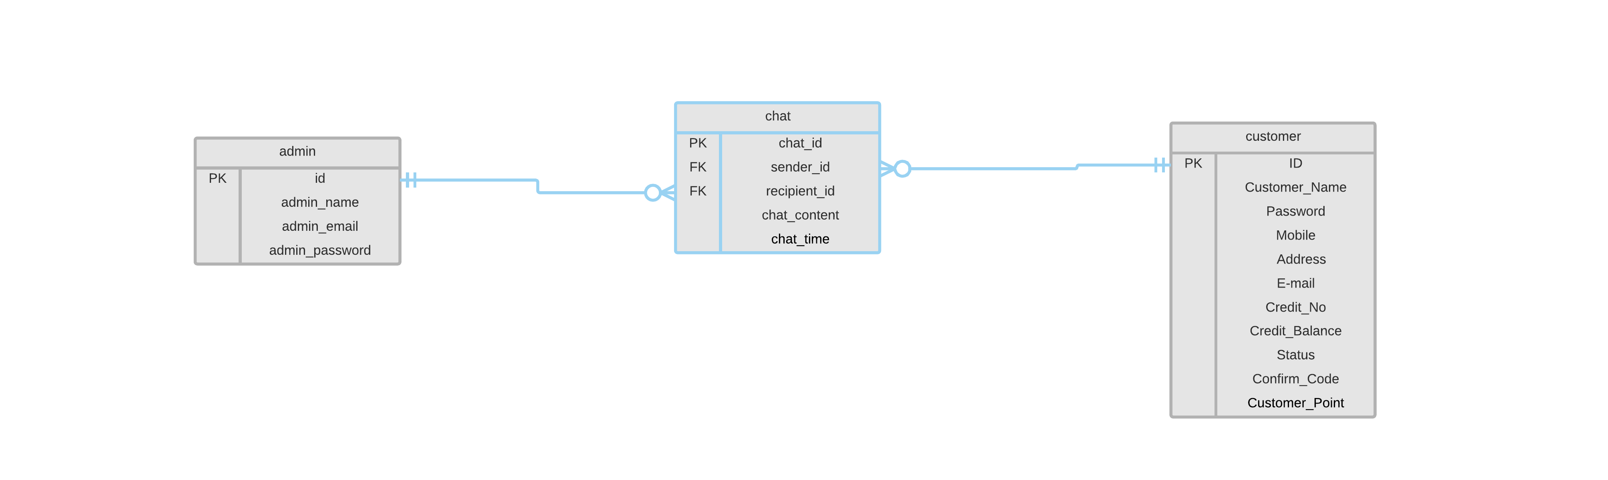

Slide 9
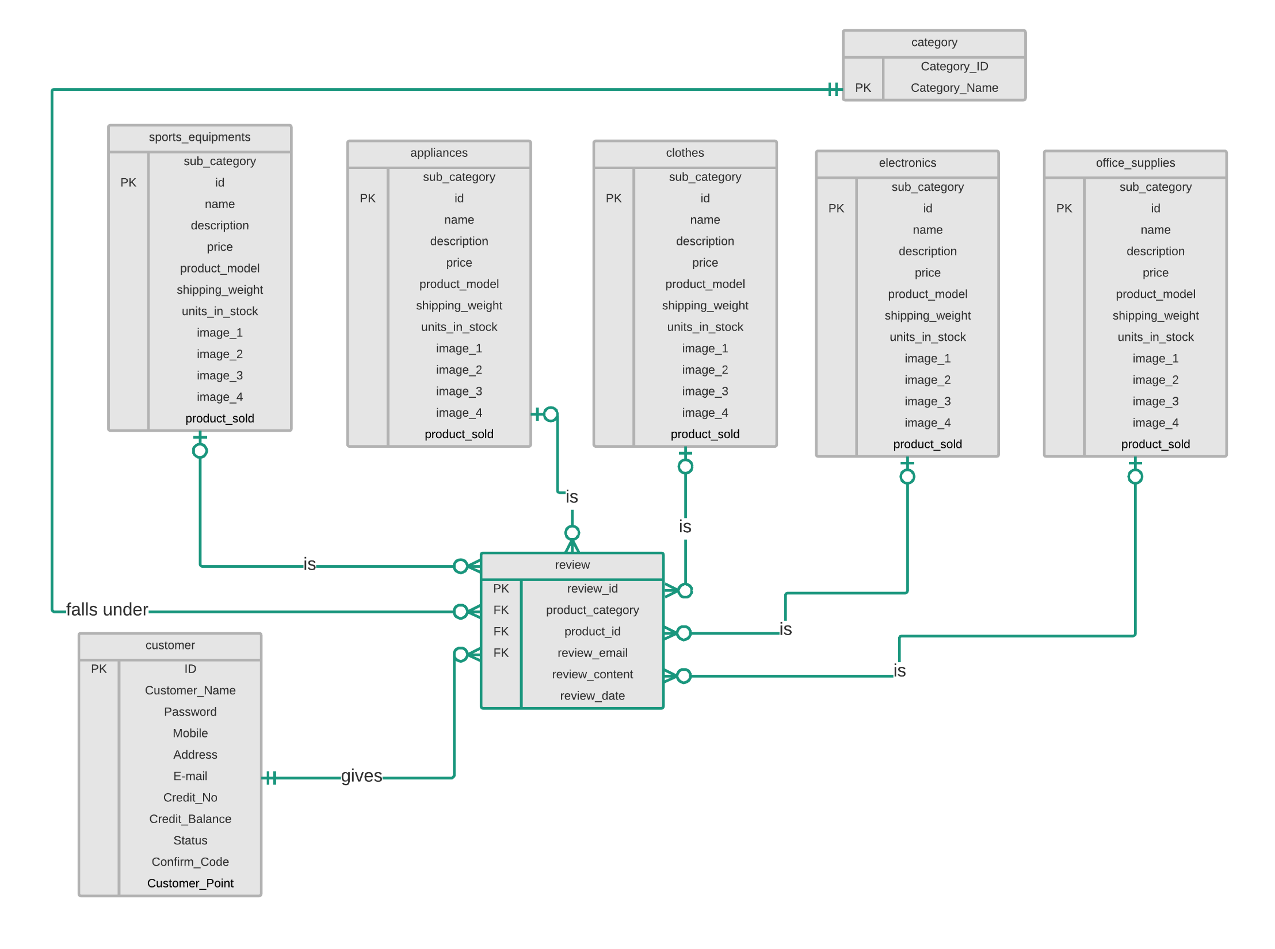

Slide 10


Slide 11

Place your screenshot here

Slide 12
MANY THANKS!
Any Suggestions ?

